Slide 1

Study Room Modelling
Team 30 :
Zi Heng 1003030
Wu Qi 1003624
Sabari 1002513
Ryan Wong 1001503

Slide 2
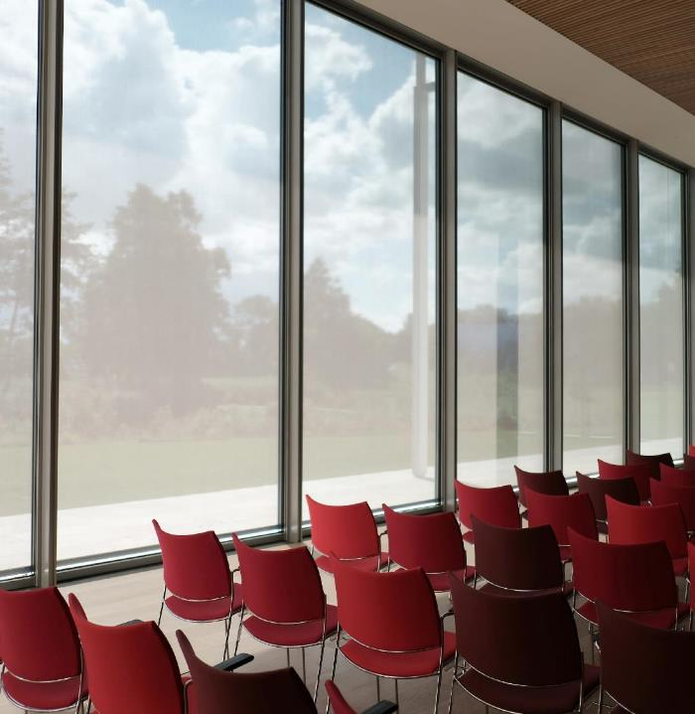
Our Group sought to model the utilization of study facilities by students in their institutions, specifically in SUTD.

Slide 3
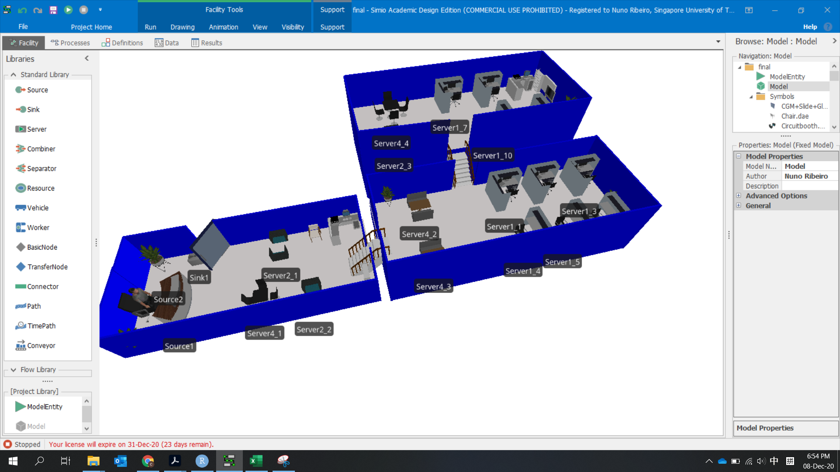
Using Simio, we create a model of study rooms and how students' groups of different sizes could utilize spaces available. *The model’s logic can be easily scaled to match any real place and accurately model them

Slide 4
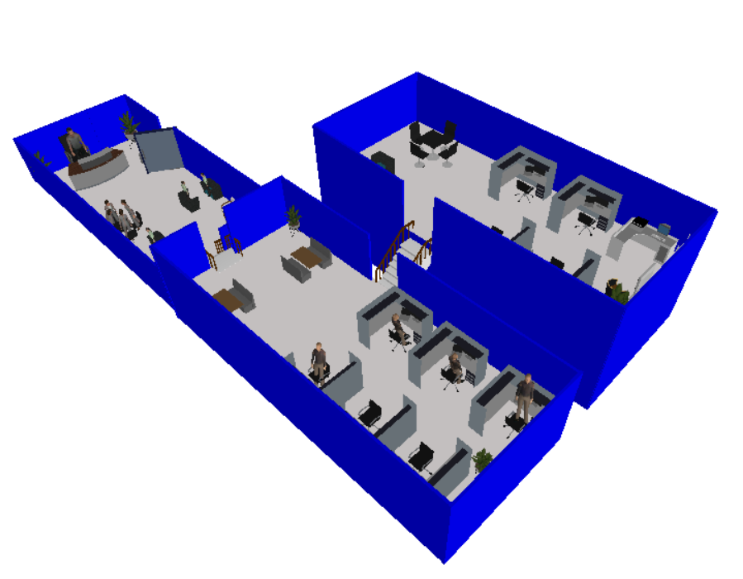
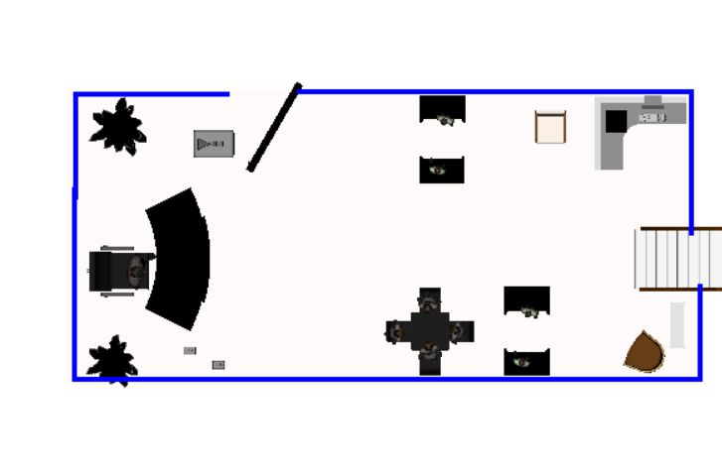
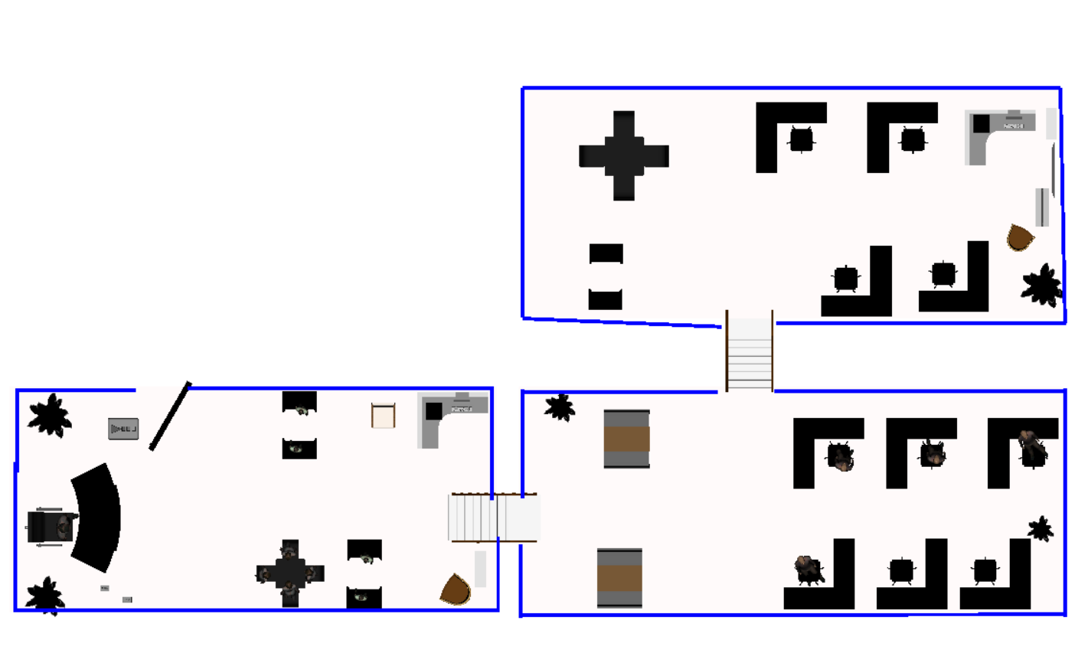
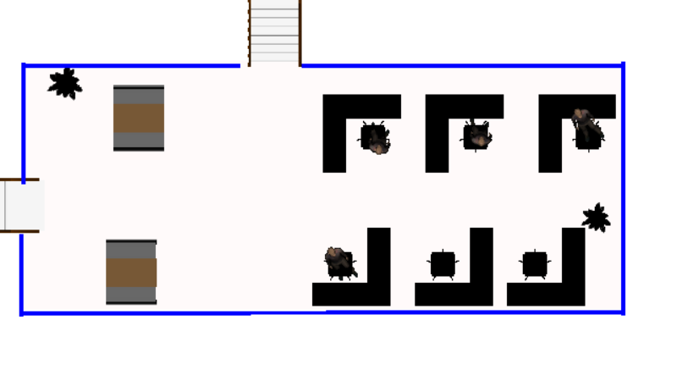
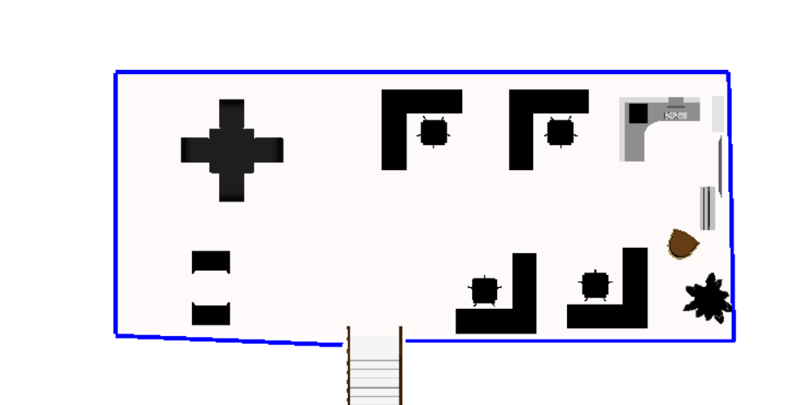
Like SUTD’s Library, our model has 3 levels. Each with a varying number of seats available.
Level 1
Entrance and Exit
2 pair seating
1 4-chair table
Level 3
Level 2
6 self-study
2 4-chair table
Level 3
4 self-study
1 pair seating
1 4-chair table
Level 1
Level 2

Slide 5
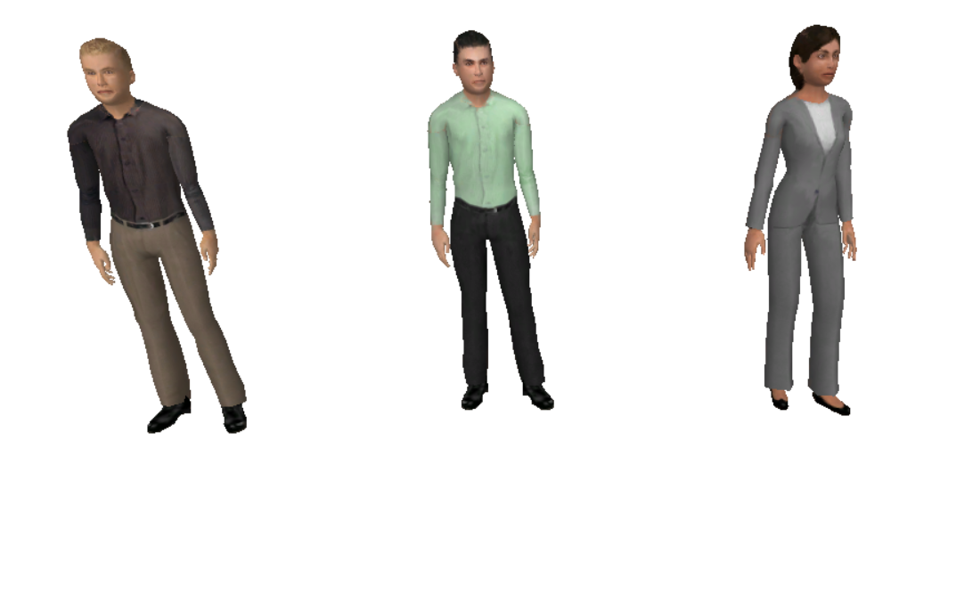
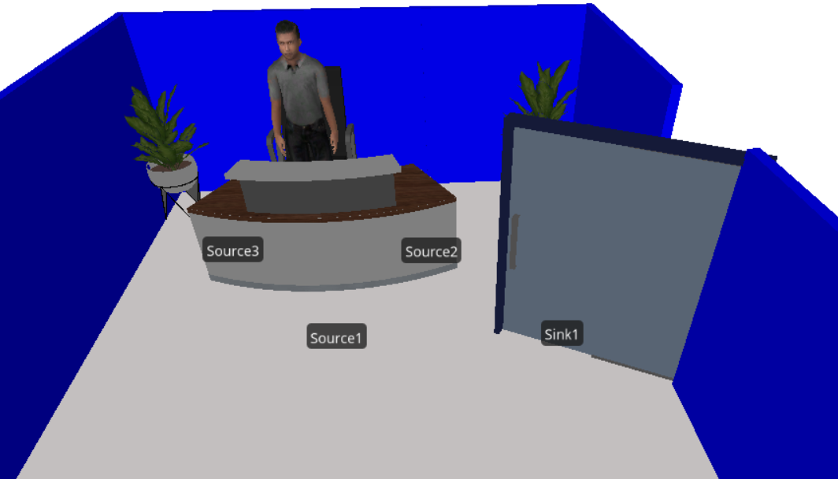
Starting at the front desk entrance, the model generates entities representing our different study groups. They then look for seats
Model Representations
Librarian
Individual
(Self-study)
Pairs
Groups of 4
If they cannot find a seat, they then leave through the exit.

Slide 6
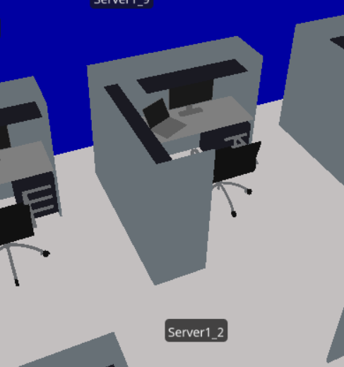
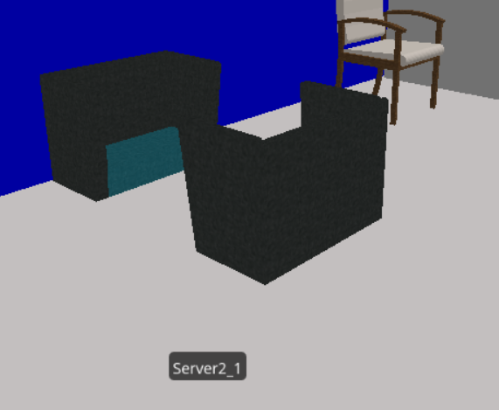
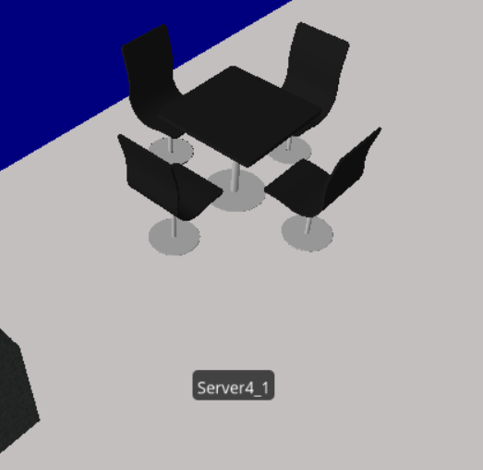
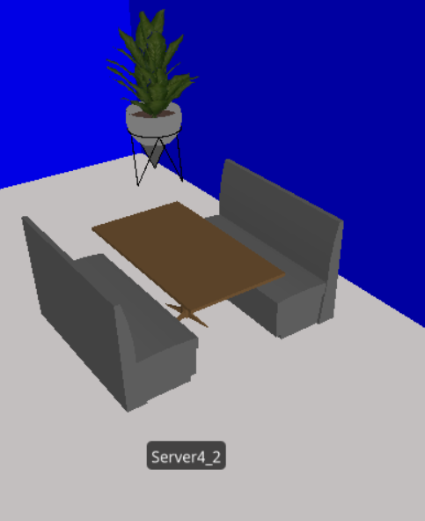
The Students, starting at Level 1, look for the closest available seat suitable for their use case. (individuals look for single seats, pairs look for pair seating, groups of 4 take tables) Once they are done studying, they leave, and the seat becomes available for the next student(s) to come along.
Individual
(Self-study)
Pairs
Groups of 4

Slide 7

Model Details

Slide 8
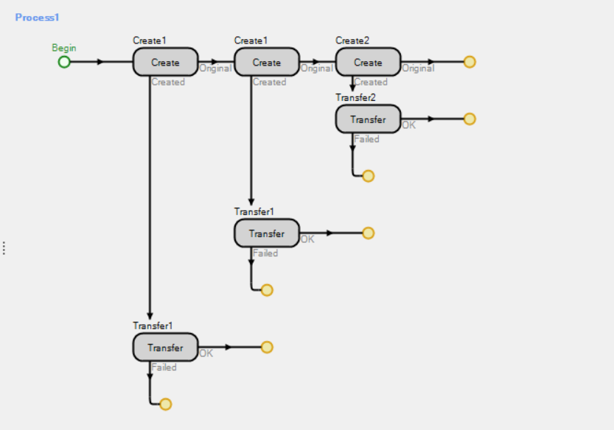
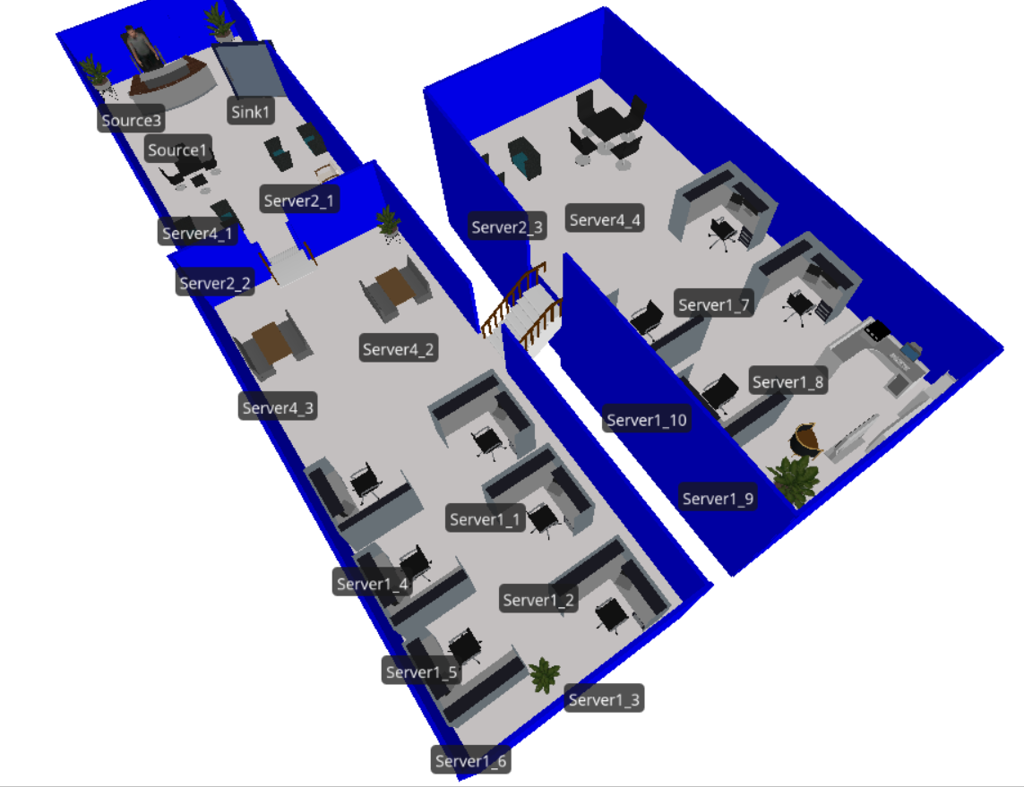
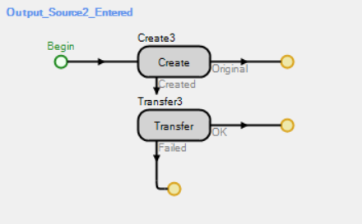
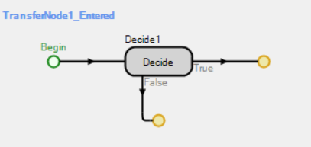
Internal Simio Logic
By building an internal logic within Simio, we modelled the behavior of students and how they move within the space to find their seats.

Slide 9
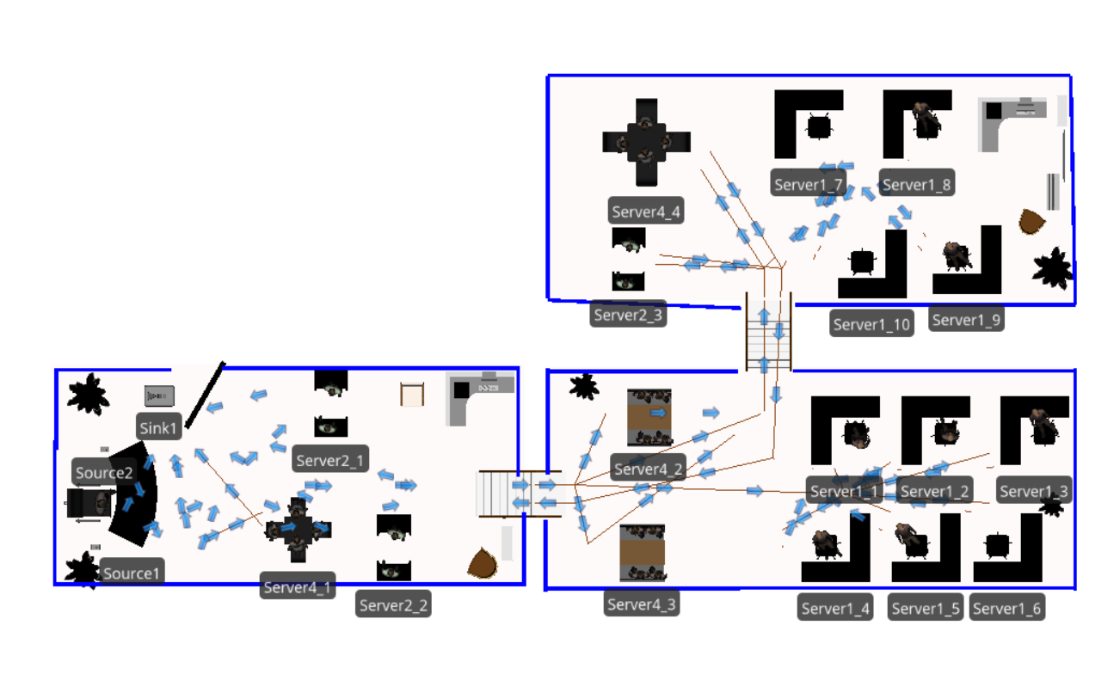
As the model is run, the system tracks each student entity and seat server, from which we can generate useable data of the students’ utilization of the space.

Slide 10
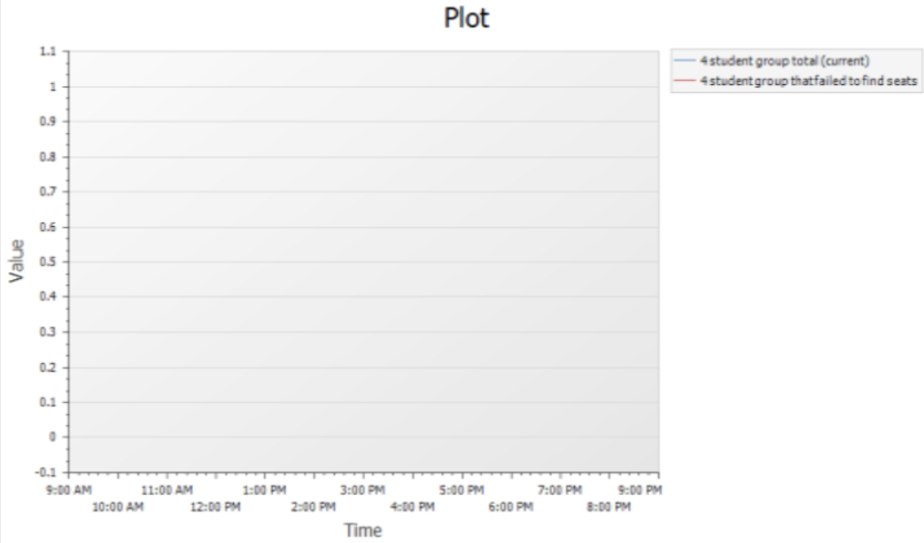
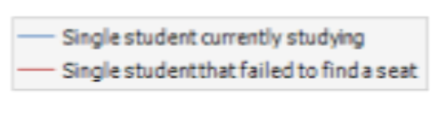
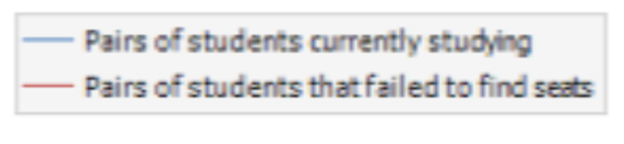
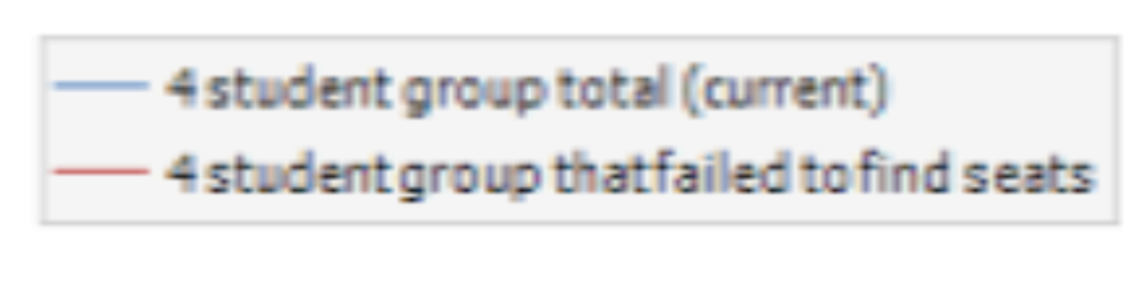
Simio’s inbuilt widgets allow accurate and visual-friendly data presentation
We built on it to provide model users with clear representation of each stat.

Slide 11
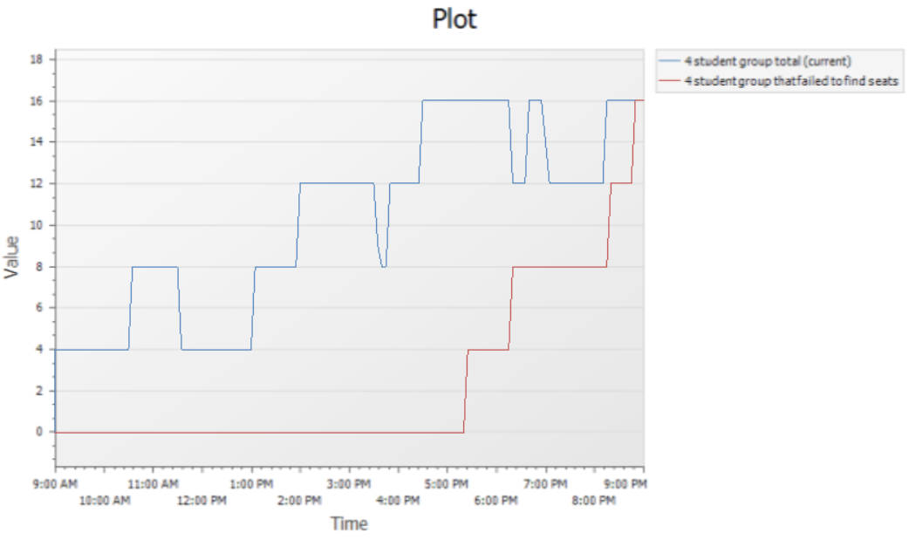
Y-axis: Number of students
Blue: in groups of 4 currently using the study rooms
Red: total number of students that failed to find a seat
X-axis: Relative time scale from 9am to 9pm.
Once run, the model self-generates all the data we need to evaluate the situation and make decisions.

Slide 12
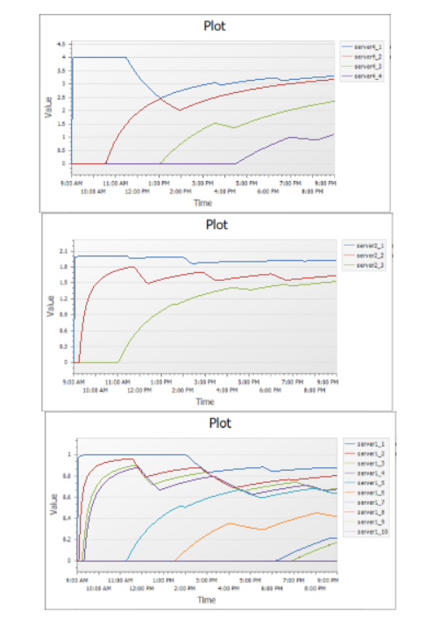
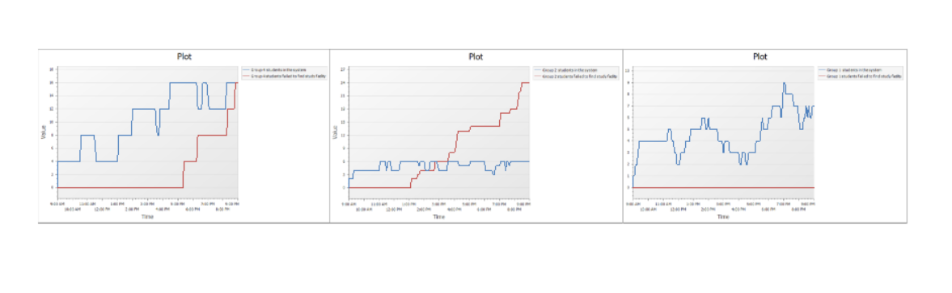
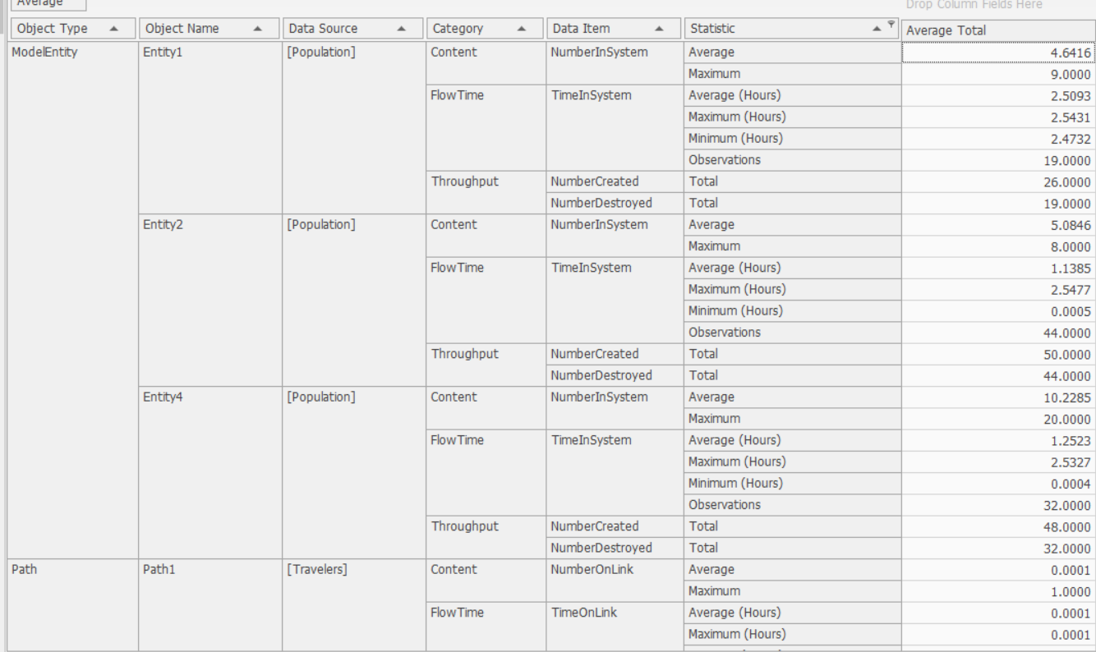
Examples of Data collectable
Current students and students that failed to find seats
Extractable data
Seat Utilization

Slide 13
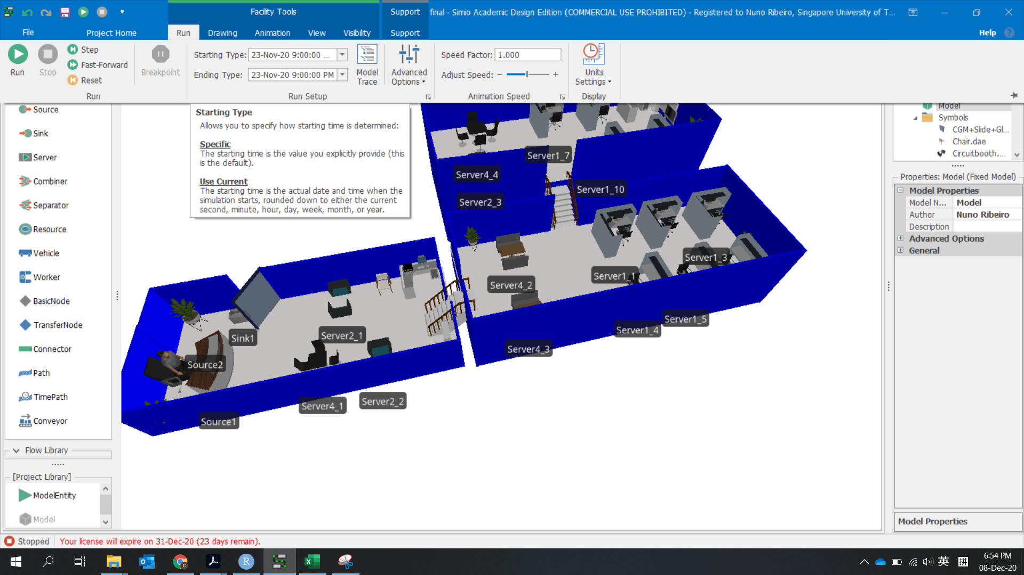
Just Click “Run”!

Slide 14



Model Performance
Operational assumptions:
Assumption 1: Student will only come with group size 1,2,4
Assumption 2: Students will use the seats that match their group size (2 students cannot use four pax seat)
Assumption 3: Students that come in as a group will always roughly leave at the same time
Assumption 4: Students will choose available seats as close to exit as possible (fill in the first level and then second level and then third level)
Assumption 5: Students interarrival time follows exponential distribution (different Mean
Assumption 6: Students study time follow normal distribution (2.5,0.02) (unit: hours)
Tracked Stats:
Students in system
Total current number of students of each type (individual, pair, group of 4)
Number of students of each type that failed to find a seat to study.
Average utilization of each seat type throughout the day
Time specific stats
14

Slide 15


University is one of the most valuable experiences of our lives.
By modelling the utilization of the spaces, we can ensure that universities are conducive educational spaces for all students in its halls.
15

Slide 16

Moving on to our Model Output Statistical Analysis

Slide 17
Terminating Simulation
Important observation: A significant number of students come in group of 2 and 4 fail to find a place to study, thus left the library
Question1: With 95% confidence level, what is the estimate of the average number of students failed to find seats so that it’s not deviate from the true mean by a small value
Question2: How many new seats should be added to decease the number of students failed to find seats to a reasonably small value

Slide 18
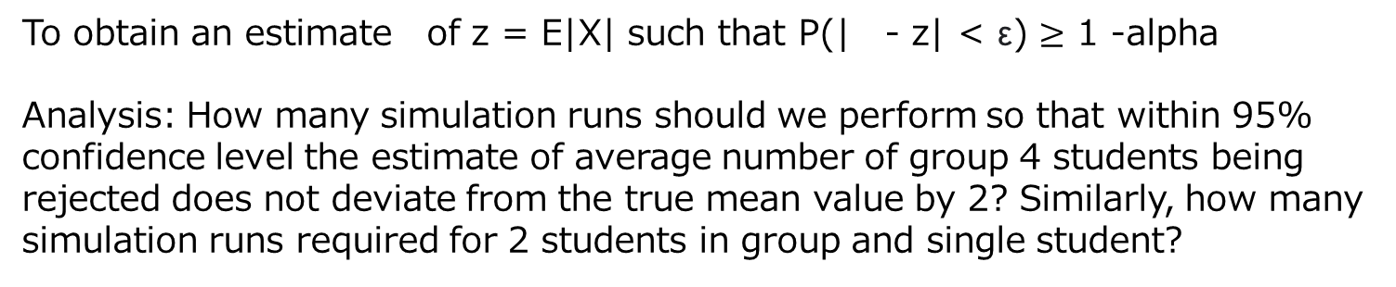
Approach
To obtain an estimate of z = E|X| such that P(| - z| < ε) $≥$ 1 -alpha
Analysis: How many simulation runs should we perform so that within 95% confidence level the estimate of average number of group 4 students being rejected does not deviate from the true mean value by 2? Similarly, how many simulation runs required for 2 students in group and single student?
Procedure:
We make 100 simulation runs to get 100 realizations of z value
Gradually increase the number of runs until our 95 % confidence interval is smaller than 8
Return the mean value of the statistic based on current number of runs

Slide 19
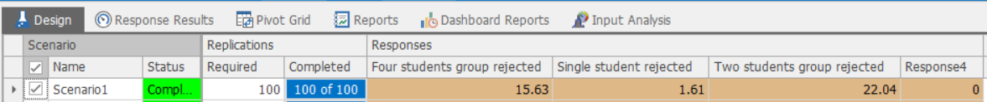
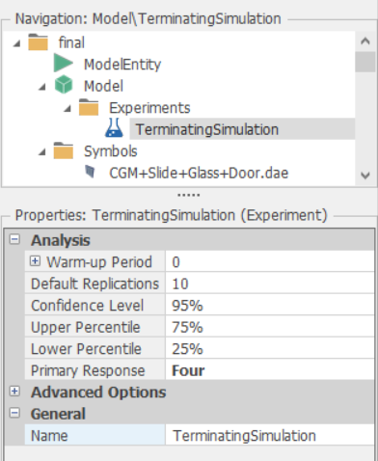
Start simulation experiment with 100 runs at the beginning
We initialize our simulation experiments with 95% confidence level

Slide 20
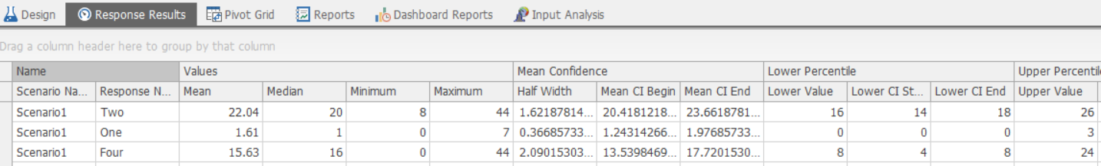
Each row represents the statistic summary of the number of students rejected from different groups
Result: Based on the first 100 simulation experiment runs, we can conclude that under 95% confidence level, 22 students of group 2, and 2 single students will fail to find a seat within give accuracy
However, we cannot draw a conclusion about students of group size 4 since the half width of the confidence interval is greater than 2
We can find the half width of the confidence interval from this column

Slide 21
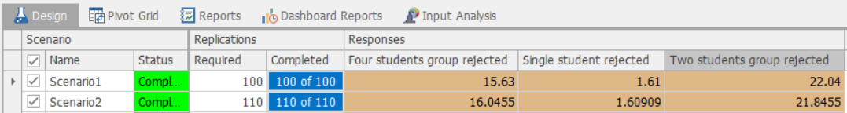
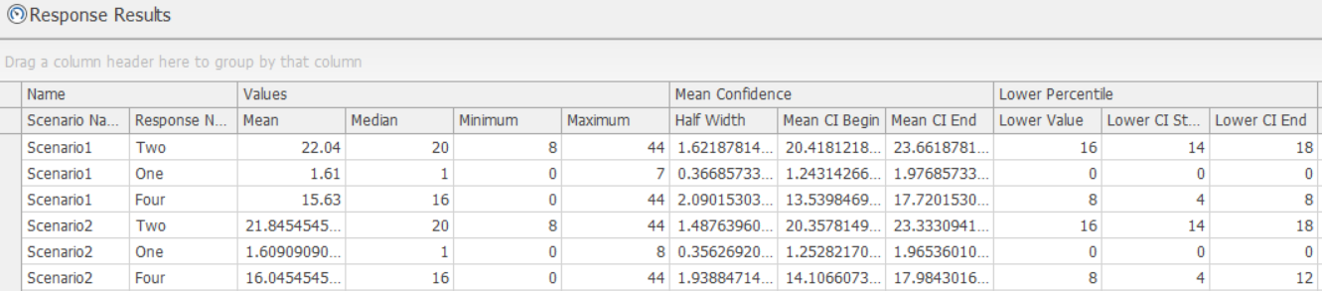
We increase the number of simulation runs by 10 for the second scenario
This time we have arrived at the half confidence interval smaller than 2, therefore, we can conclude that with 95% confidence level and 110 simulation runs, the estimate of average number of group 4 students failed to find seats is 16

Slide 22
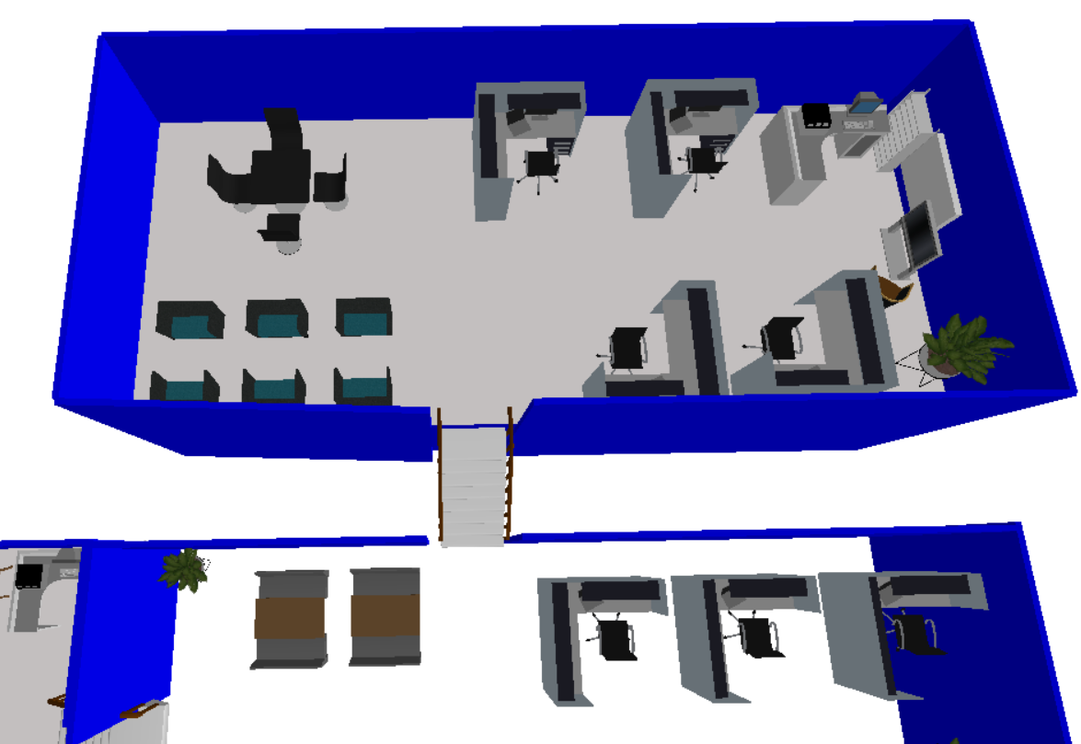
Question2: How many new seats should be added so that the number of group 2 and 4 students being rejected will not exceed 5 with current confidence level and accuracy?
Approach： Add one more 4-pax seat and 2 more 2-pax seat and rerun 110 simulations
Newly added seats

Slide 23
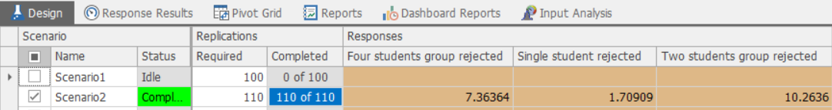
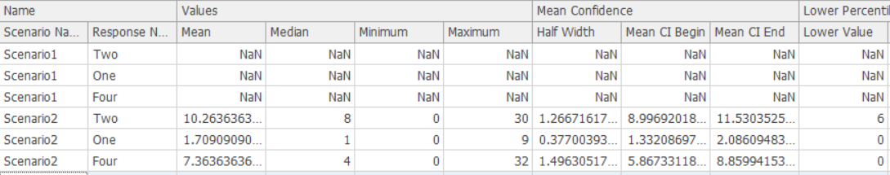
We run another 110 simulations
However, the result shows both values are greater than 5, meaning that with current confidence level and accuracy, there are still more than 5 students from group size 4 and 2 cannot find seat throughout the day
We need to add more seats!!

Slide 24
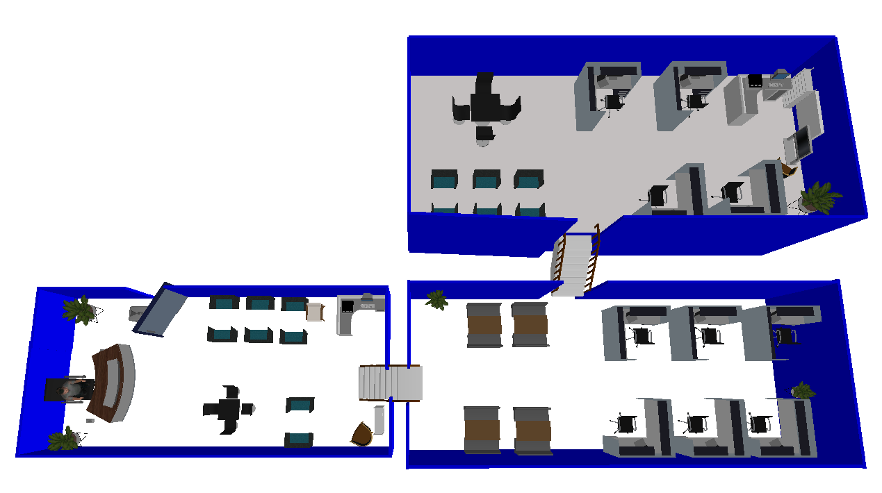
We add two more 2-pax seat and one more 4-pax seat and run 110 simulations again
Newly added seats

Slide 25
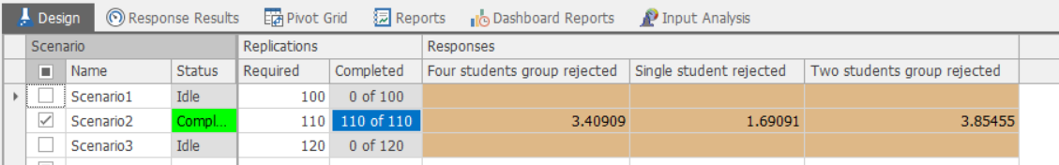
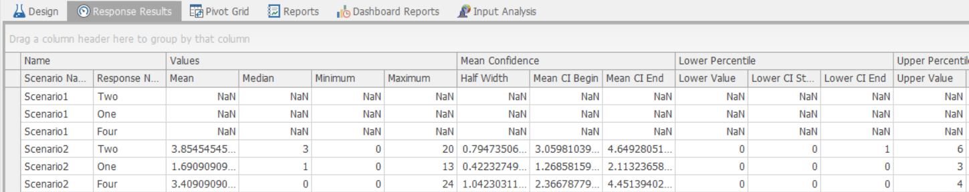
We add two more 2-pax seat and one more 4-pax seat and run 110 simulations again
Conclusion: If we want to have less than 5 students be rejected throughout the day, we need to add 4 2-pax seats and 2 4-pax seat, but our model is always scalable to cater to different requirements!!!
This time we have achieved total number of students rejected less than 5 for all groups with low variance !!

Slide 26



System comparison
We want to compare the performance of two systems – the current system and the system with one more study table in terms of the balance between student satisfaction and the overhead of additional facilities.
Adding additional study table will not only decrease the number of students being rejected, but also decrease the utilization of the corresponding type of study table.
The trade-off between the two factors is defined as μ = a·X1 - b·X2, where
X1 -- the number of students in different group size rejected by the system in one simulation;
X2 -- the average utilization of each type of study table;
a -- the significance coefficient of X1;
b – the significance coefficient of X2.
26

Slide 27
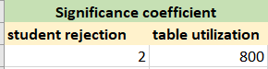
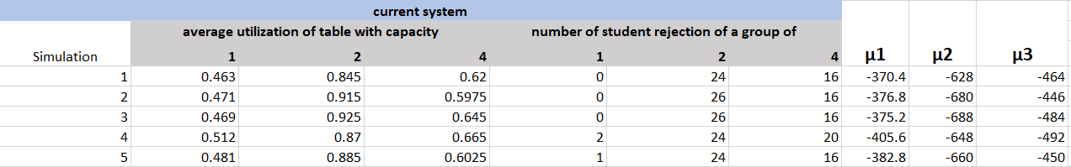
Modeling process
E.g. a = 2, b = 800
To put the value of study table utilization to the same level as number of students being rejected.
20 simulation runs were ran to get the average utilization of table with different capacity and the number of students being rejected of different group size.
μ is calculated by μ = a·X1 - b·X2 from each simulation run. The small the value of μ is, the undesired the system is.
The same process was done on a new system with one more study table. μ1᾽, μ2᾽ and μ3᾽ was obtained.

Slide 28
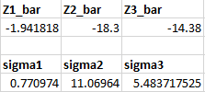
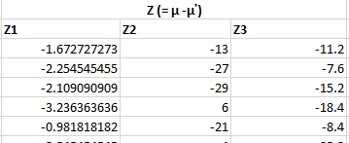
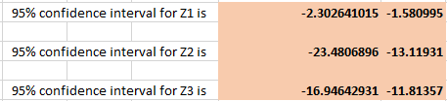
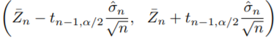
Modeling process
Z = μ -μ᾽.Thus,
Z1 = μ1 – μ1᾽
Z2 = μ2 - μ2᾽
Z3= μ3 – μ3᾽
¯
is the mean of the sum of Z value for 20 simulation runs.
Z
σ is the standard deviation of all Z values.
The confidence interval is calculated by
Conclusion
If the value interval of Z is below 0 , system 1 has a smaller μ value compared with system 2. Then, system 1 is preferable;
If the value interval of Z is above 0 , system 1 has a larger μ value compared with system 2. Then, system 2 is preferable;

Slide 29


Thank you!
29

